Slide 1
User Profiles with GPS-Based Survey Data
Modeling Mobility Conference 2025
Minneapolis, Minnesota

Slide 2
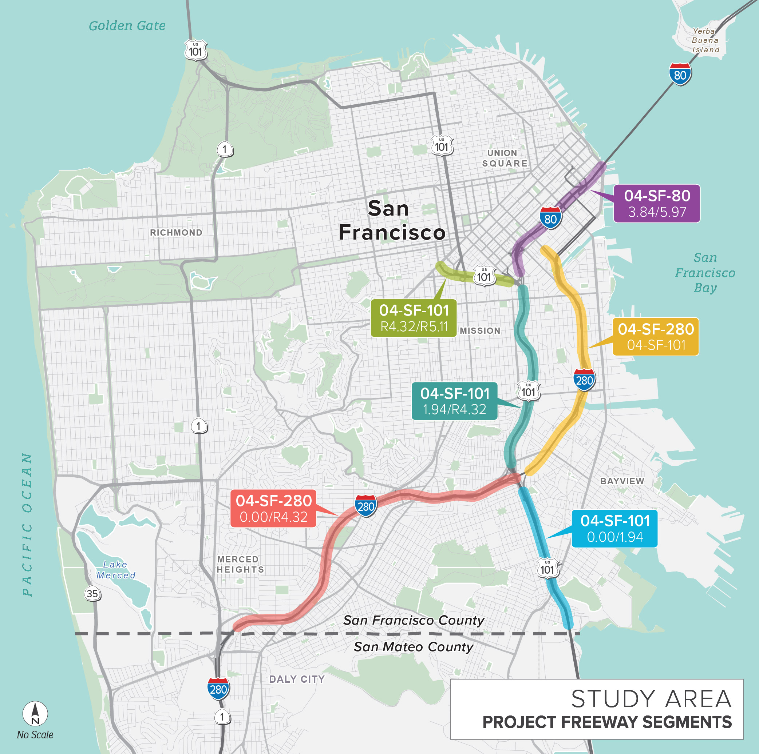
Purpose and Need
San Francisco Freeway Managed Lanes Study
User profiles to inform tolling case
Equity analysis

Slide 3
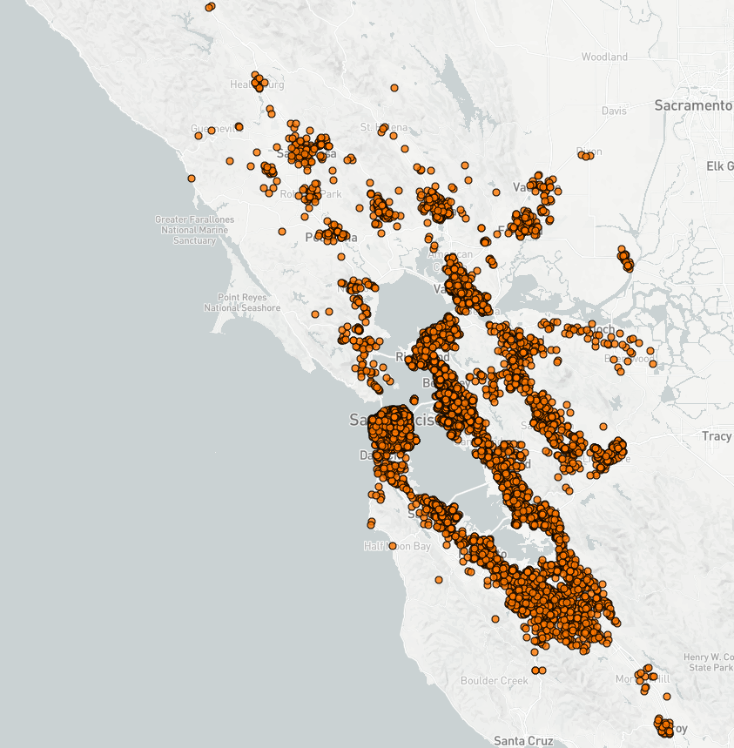
Data and Methods
Data
2023 Bay Area Travel Study (BATS 2023)
Household and person demographics
Trip records with GPS paths
Open Street Map (OSM)
Methods
Route GPS points from BATS 2023 trips onto OSM network
Identify study freeway segments in OSM network
Extract trips using study freeway segments
Prepare demographic summaries

Slide 4
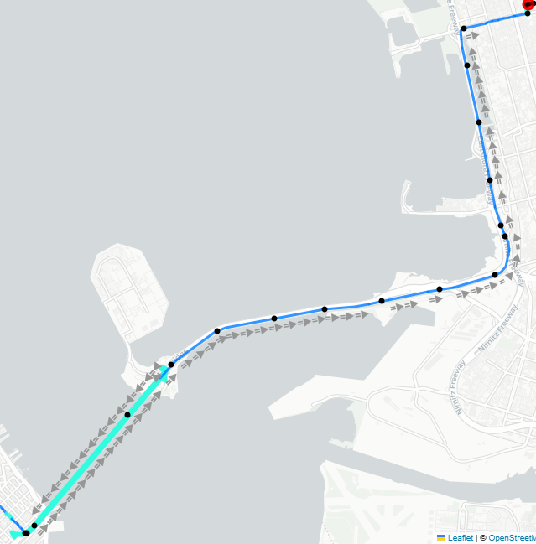
Tools
Trip trace conflation w/ mappymatch
https://github.com/BayAreaMetro/Travel-Diary-Surveys/tree/master/trip-trace-conflation
Path explorer (jupyter notebook)
https://github.com/sfcta/travel_diary_survey_scripts/blob/master/visualization_tools/explore_paths.ipynb

Slide 5
Example Results

Slide 6
Next steps
Develop tests for match quality
Evaluate quality against alternative matcher
https://github.com/BayAreaMetro/survey_scripts_tnc2019/tree/master/_4_map_match
Identify improvement opportunities

Slide 7
Thank you.
sfcta.org
Drew Cooper
Principal Transportation Modeler
drew.cooper@sfcta.org
415-522-4814 office

